Slide 1
AI based Virtual mouse
Date:-12-03-2022
Ayushman Tripathi
ECE
211010220
Ganesh prajapati
ECE
211010223
Vipulesh
ECE
211010258
Vedica Mishra
ECE
211010255
International Institute of Information Technology, Naya Raipur
Notes:
1

Slide 2
Contents
Hand Tracking Module
Its Algorithm
AI Virtual Mouse
Its Algorithm
Future scope
Conclusion

Slide 3
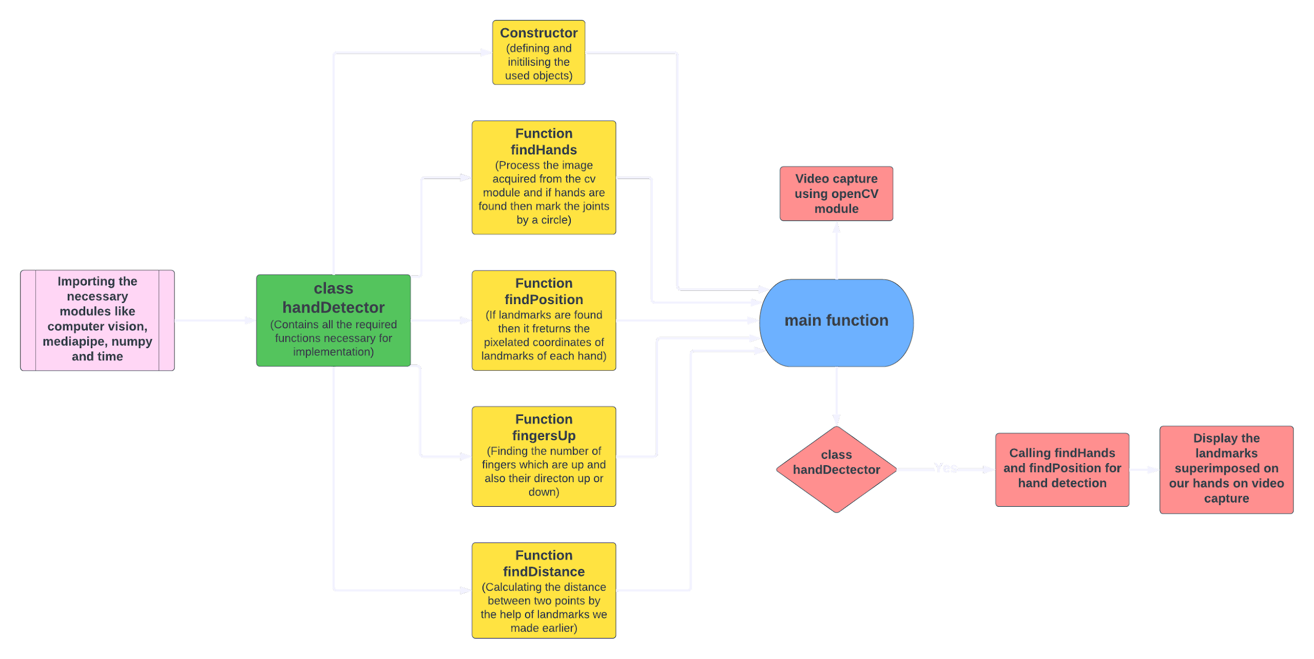
Hand Tracking Module

Slide 4
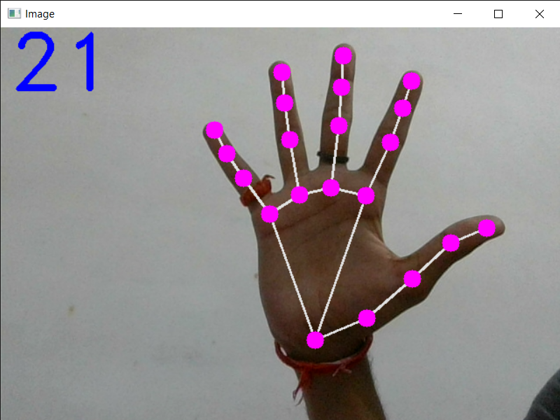
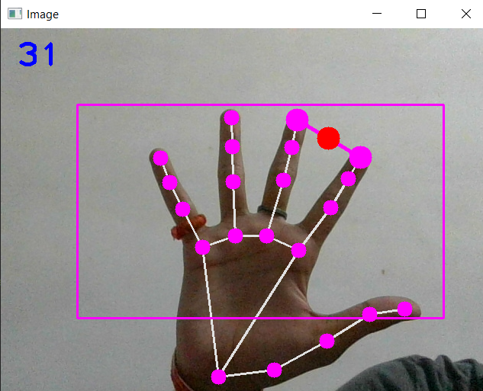
Algorithm of the Hand tracking module
Initially we convert the input image from bgr format to rgb format for recognition.
After detection, we plot the joints of our hands to convert them to landmarks for further tracking.
Now, we check which finger is open for use(for the movement of cursor or clicks.
Then, we find the distance between two fingers for performing the click operation.This is measured by the relative distance between the plotted circles of the two fingers.

Slide 5
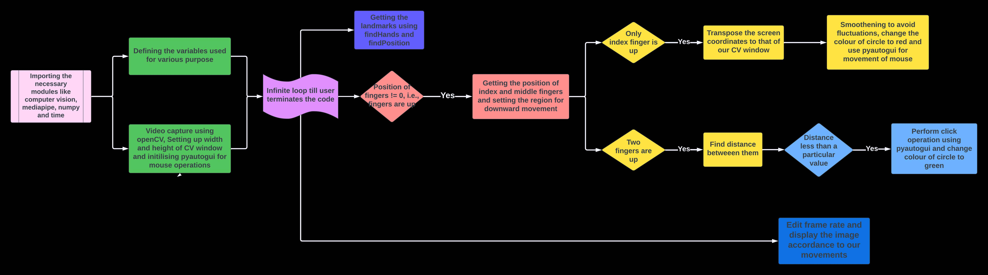
AI Virtual Mouse

Slide 6
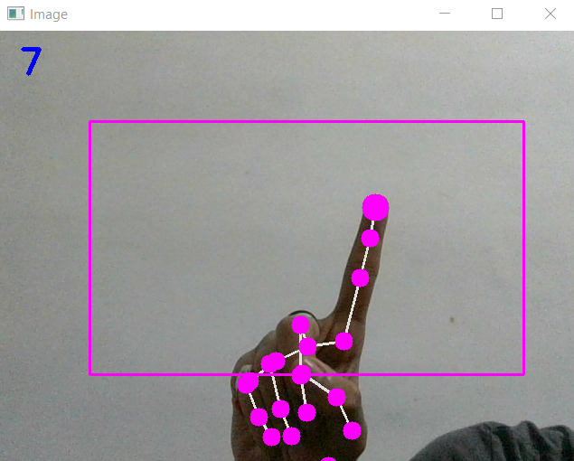
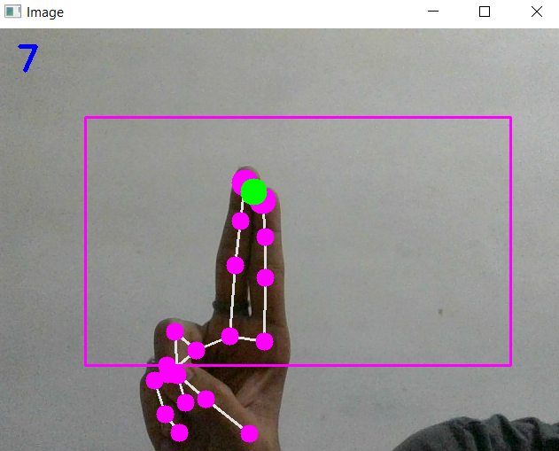
Algorithm for AI virtual mouse
This function is mainly focussed on live tracking of our hand and control of the mouse pointer.
Firstly we all the necessary modules out of which the handtracking module is created by us.
Now we check the status of the fingers to know the operation being performed by the user.
When a single fingertip is detected, the cursor operations are performed. The finger up operation is simple but for finger down, specification of region is required.
Now we convert the size of our virtual window and smoothen the movements of cursor.
Finally pyautogui is used to move the cursor accordingly.
For the click mode,we just check for the minimum distance between two fingers.

Slide 7
Future scope
Further functionalities like scrolling can also be added.
The virtual mouse can replace the laser pointers used in the presentations.
Using this techniques we can also control drones, bionic arms and other highly technologies based on the usage of Artificial Intelligence and Computer Vision.

Slide 8
Conclusion
From the results of the model we conclude that:
The proposed system has performed very well and has greater accuracy than the existing systems.
It can helpful in reducing the spread of covid-19 since the system is virtual.
However, our model has a few limitations that is the inaccuracy in the right click and no provision of scroll function
We will work on these limitations by improving the fingertip algorithm.

Slide 9

Thank You
..
Dr. Shyama Prasad Mukherjee International Institute of Information Technology, Naya Raipur
16-02-2021
International Institute of Information Technology, Naya Raipur
9

Slide 10

Questions

